Slide 1
Prioridades y demandas futuras en materia de espectro
Lucas Gallitto
Public Policy Director
GSMA

Slide 2






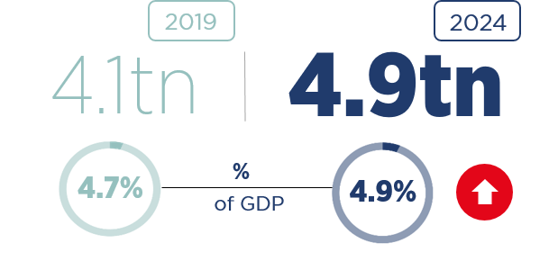


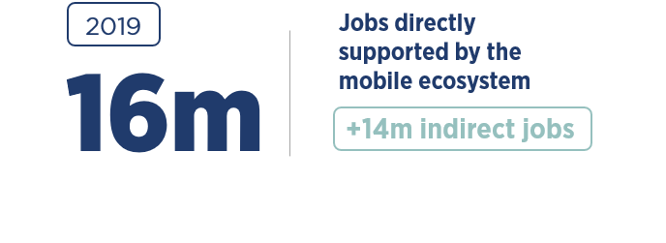


Mobile and the Power of Spectrum
No one has done more with their spectrum to deliver a better future for everyone than the mobile industry

Slide 3
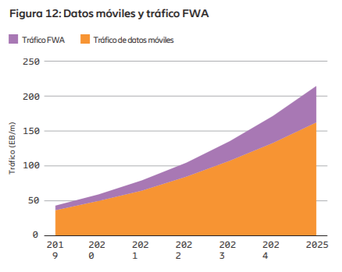
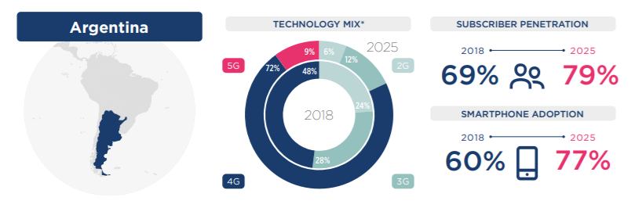
Traffic and connections will continue to grow
No one has done more with their spectrum to deliver a better future for everyone than the mobile industry

Slide 4
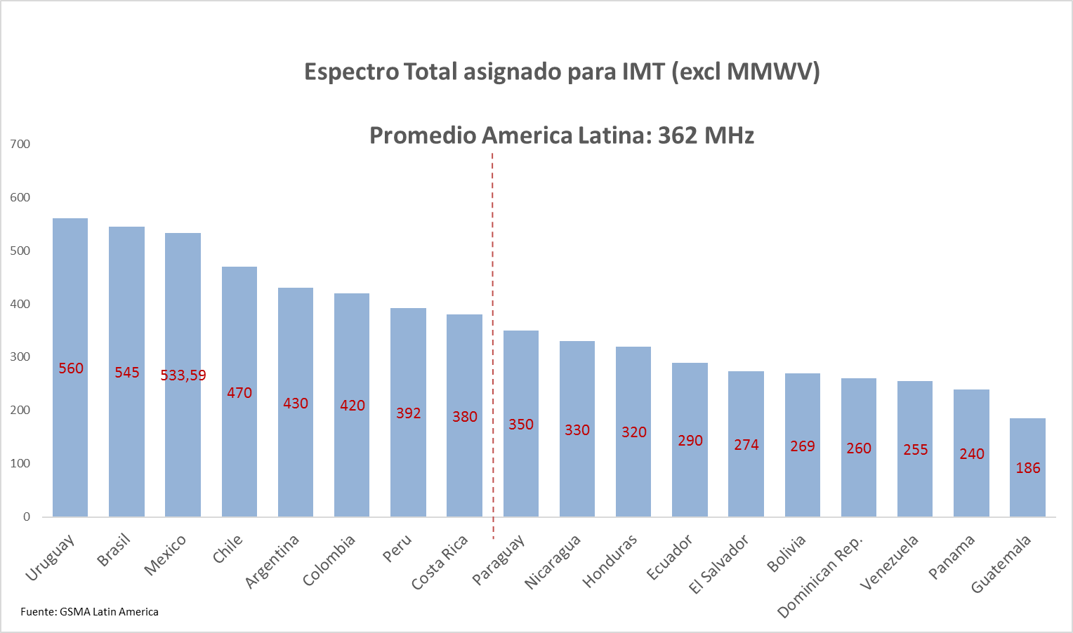
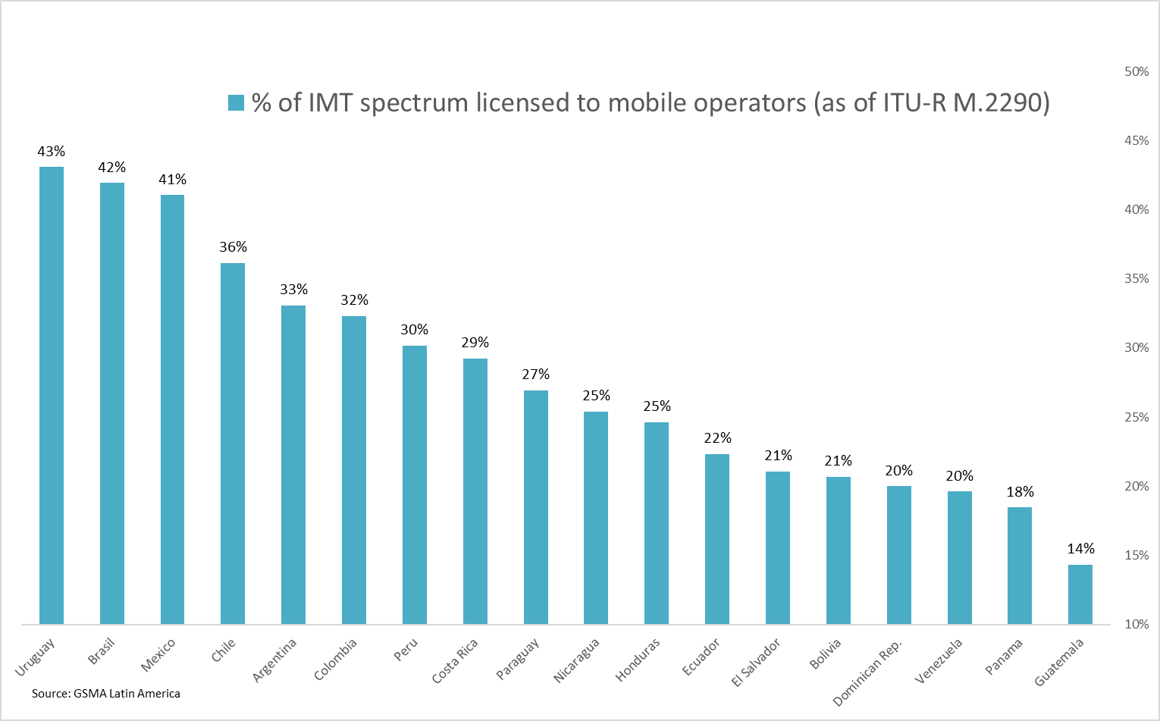
Spectrum roadmaps are key

Slide 5
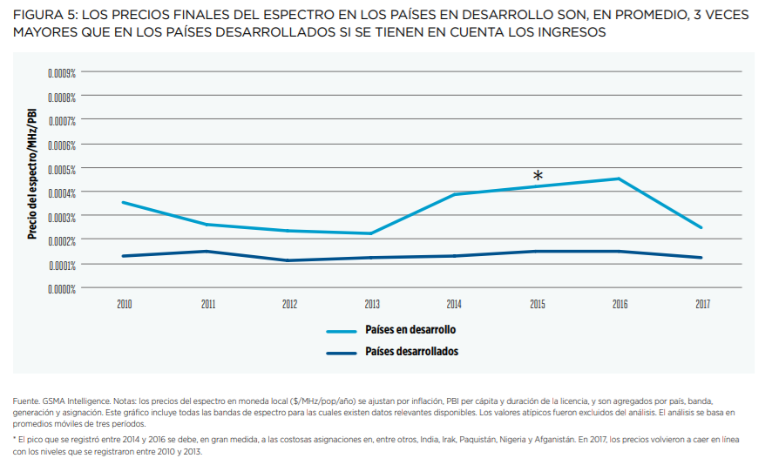
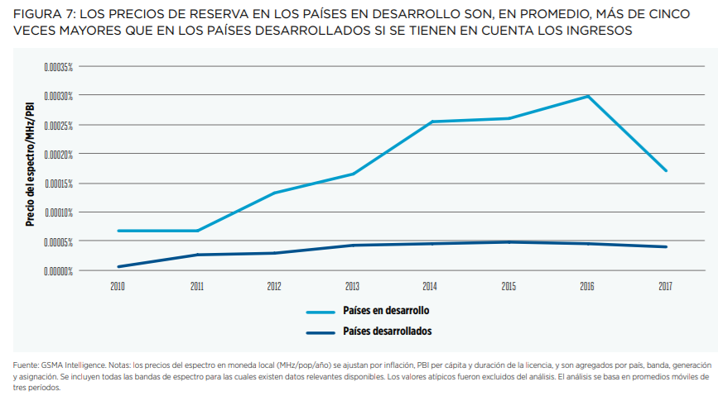
As well as the conditions for assignment

Slide 6
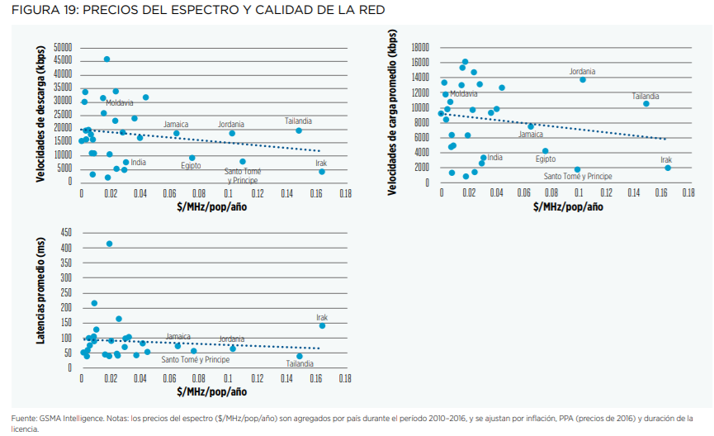
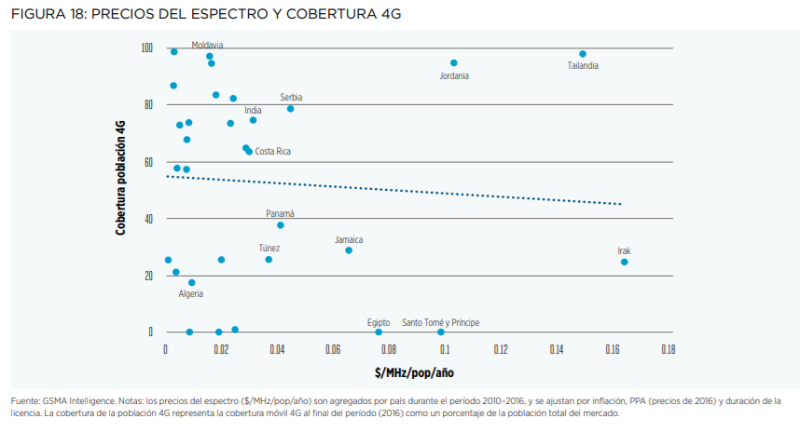
Priority should be inclusion and innovation, not revenue

Slide 7

WRC-23: Spectrum Needs of 5G
Low-band
Mid-band
Capacity bands
Agenda Item 1.5 considers 470-960 MHz
3300-3800 MHz
4800-4990 MHz
6425-7125 MHz
10-10.5 GHz can add to existing mmWave capacity

Slide 8
WRC-23: Solutions for Three Familiar Challenges
Harmonisation
Further harmonisation in core bands – like 3.5 GHz – for global ecosystem
New harmonised spectrum for 5G expansion – e.g. 6 GHz
Cost-Efficiency
Ensure 5G has sufficient channel bandwidth: 3.5 GHz, 4.8 GHz, 6 GHz
Channel size will lower network density and increase affordability
Coverage
City-wide capacity solutions (AI 1.1, 1.2, 1.3)
Low-band spectrum for rural 5G and universal IoT (AI 1.5)

Slide 9




Conclusion: WRC-23 has solutions
Regional advances reflected in radio regulations will build ecosystem for global consumers
Access to core mid-band spectrum in 3.5 GHz range is crucial
Harmonisation
Cost-Efficiency
Sufficient channel size for 5G must available at e.g. 3.5 GHz
Lower network density will reduce costs
Coverage
Long-term solution to sub-1 GHz must also be found (AI 1.5)

